Slide 1

Superstore Sales Performance Analysis
Prep by: Jalen Bullard
Date: Jan 2026
Data Analyst Project

Slide 2
Identify Revenue Drivers, Profitability Risks, and Regional Performance Gaps (2014–2017)
Business Objective
—---------
The objective of this analysis was to evaluate company sales and profitability performance from 2014–2017 across product categories and regions. The analysis identifies primary revenue and profit drivers, regional demand imbalances, and areas of profitability risk, with the goal of informing data-driven operational and strategic decisions.

Slide 3
Sales Growth Is Driven by Technology Performance and Regional Demand Imbalances
—---------
Sales exhibit sustained long-term growth with pronounced year-end seasonality, indicating reliable demand patterns alongside short-term volatility.
Technology is the primary revenue and profit driver, generating the highest total sales and consistently positive profits across all regions.
Regional performance varies significantly, with East and West outperforming company benchmarks, while South and Central lag in both sales and profitability.

Slide 4
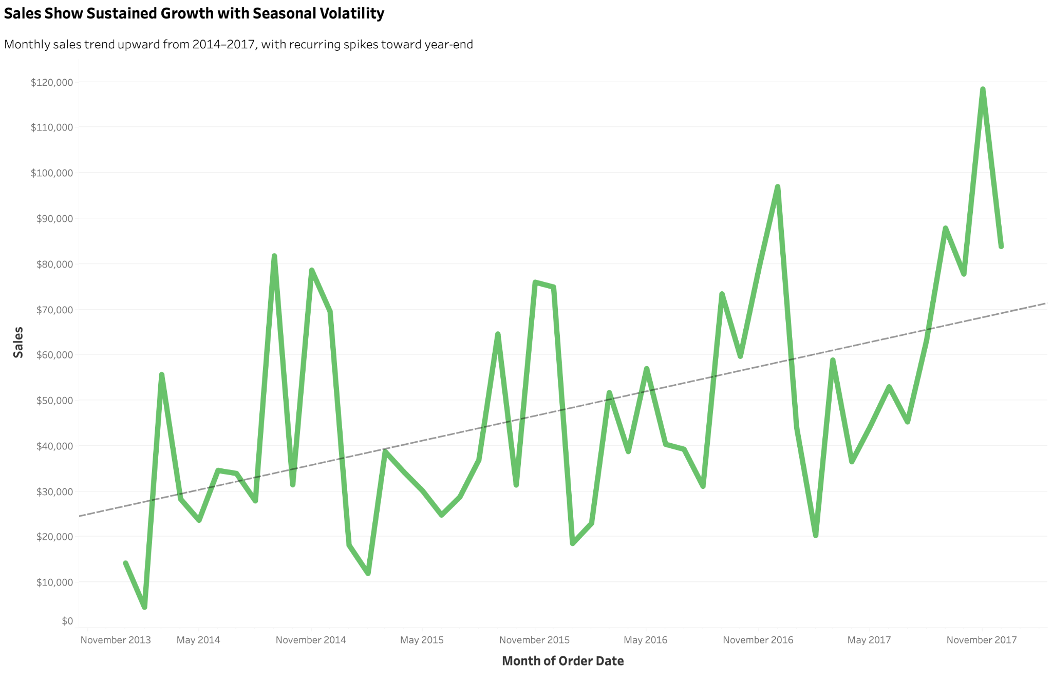
Sales Exhibit Sustained Long-Term Growth With Predictable Year-End Spikes
Sales demonstrate a sustained upward trend over the long term.
Notable month-to-month fluctuations indicate the presence of seasonality.
Significant increases in sales typically occur at the conclusion of each year.

Slide 5
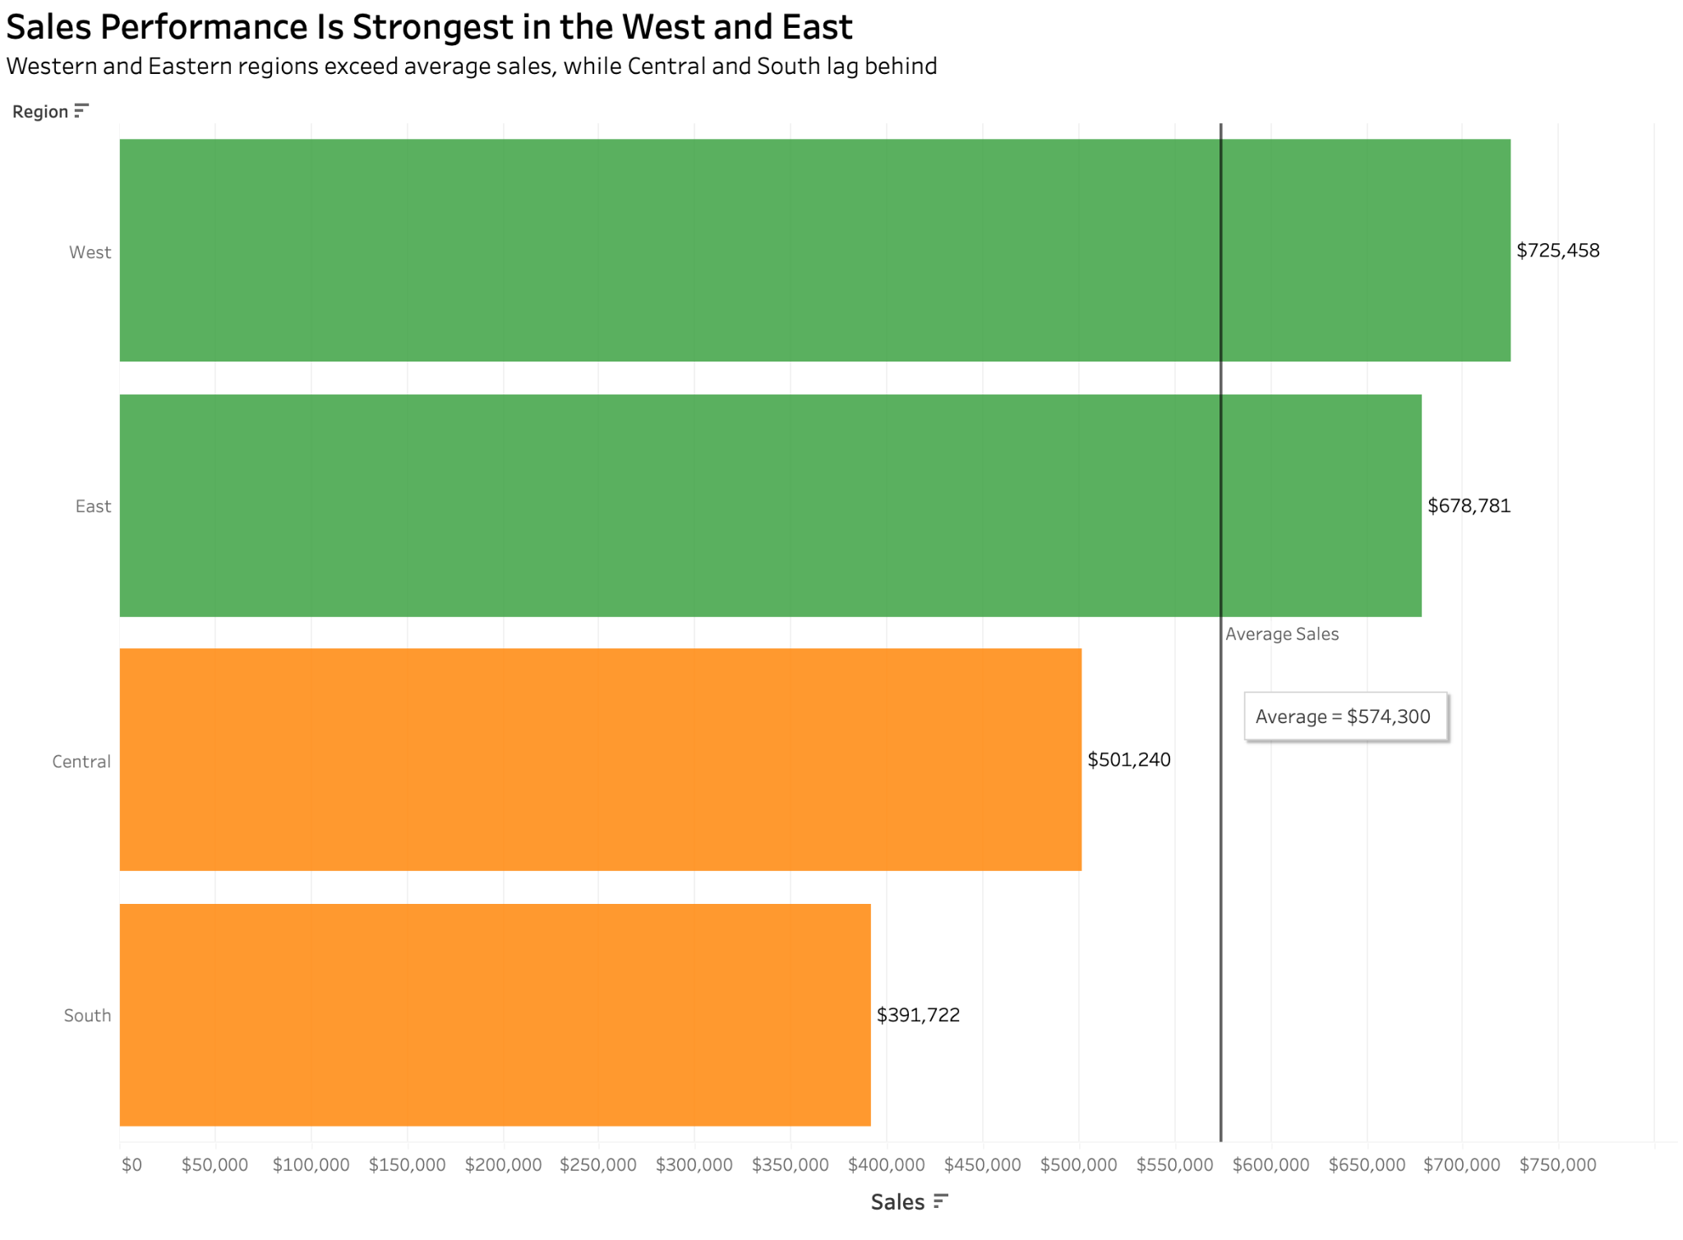
West and East Regions Generate the Majority of Revenue While the South Lags
The western region reports the greatest overall sales.
East trails in near proximity
South persistently underperforms in comparison to other regions

Slide 6
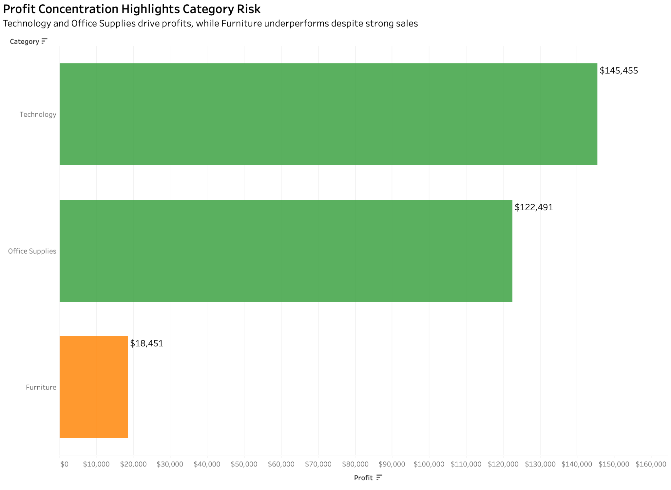
Technology Accounts for the Highest Profit While Furniture Creates Margin Risk
Technology yields the most significant aggregate profit.
Office Supplies maintains consistent yet modest profitability.
Furniture represents the least profitable category.

Slide 7
Targeted Investments Can Improve Profitability and Reduce Regional Risk
Business Objective
—---------
Increase strategic investment in Technology products, focusing on high-performing East and West regions.
Conduct margin and cost structure analysis within the Furniture category to address persistent profitability challenges.
Develop targeted regional strategies for the South to improve sales penetration and operational efficiency.
Leverage identified seasonal demand patterns to improve inventory planning and promotional timing.

Slide 8
Data-Driven Actions Are Expected to Improve Profit Margins and Regional Performance
Business Objective
Improved profitability through focused investment in high-margin Technology products.
Reduced margin leakage by addressing Furniture category cost inefficiencies.
Increased regional performance consistency via targeted South region initiatives.
More accurate inventory and staffing decisions driven by seasonality-aware planning.

Slide 9
Thank You!

